Slide 1
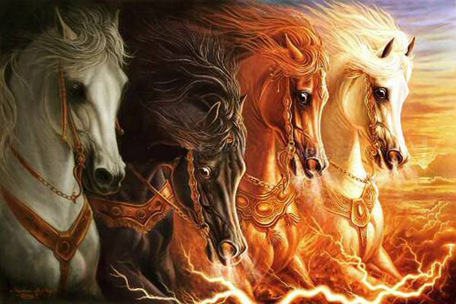
ZECHARIAH
Prophecies for the Last Days

Slide 2
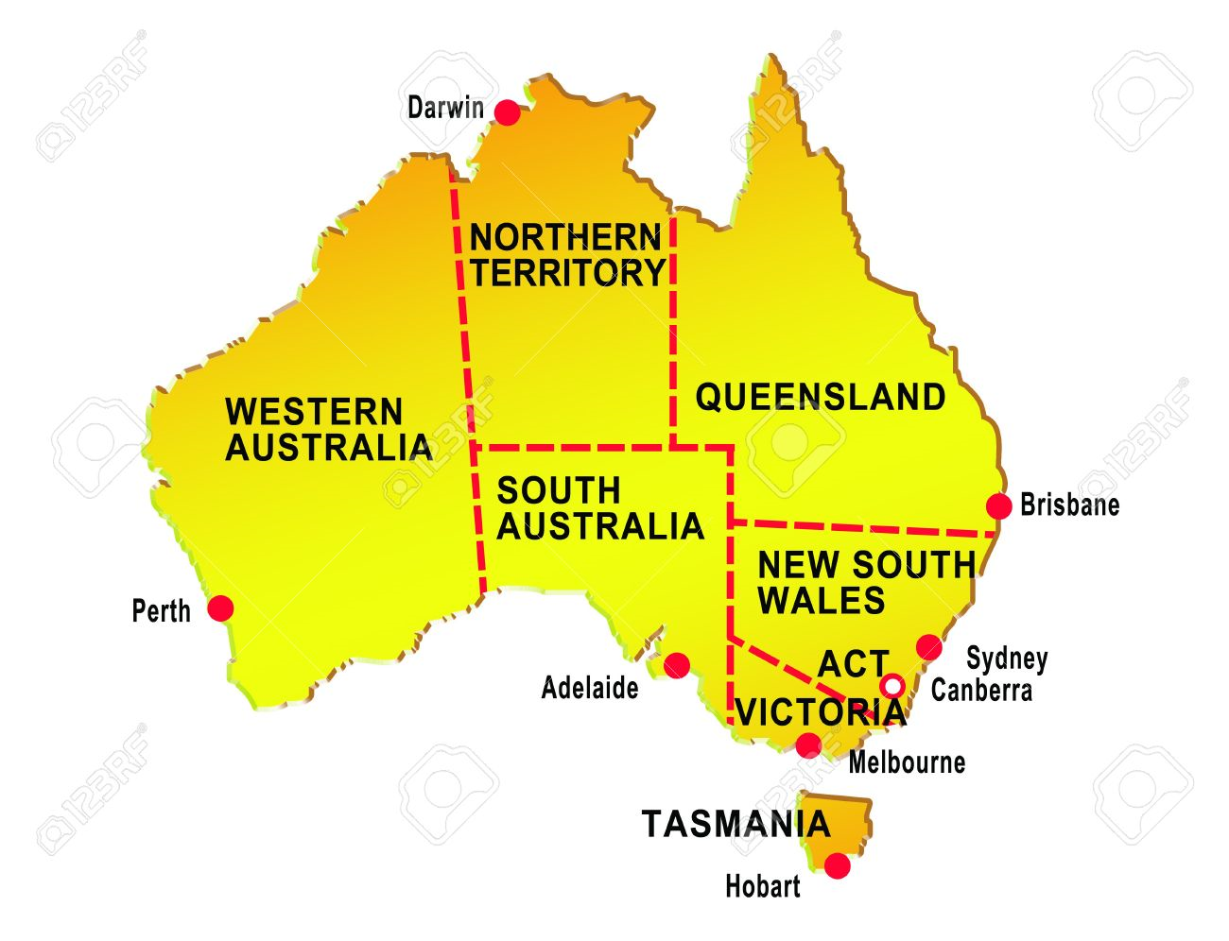

Slide 3

Neville
Anna
Sarah
Jo
Beks
Laura
Jess

Slide 4
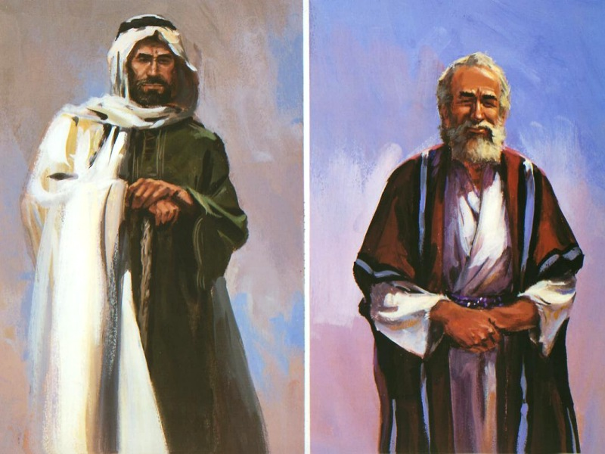
Zechariah
Prophecies for the Last Days
They Built the House of Yahweh Ezra 3
The Deputation from Bethel Zech 7
Thy King Cometh Unto Thee Zech 9
Yahweh hath Visited his Flock Zech 10
The Rejection of the
  Good Shepherd Zech 11
They Shall Look upon me
    Whom They Have Pierced Zech 13
    7 The Day of Yahweh Cometh Zech 14
The
Series

Slide 5

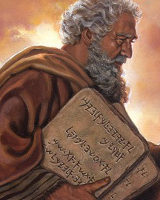
Moses the Man of God
Moses
The Man of God
Moses the Hebrew Ex 2
Moses the Fugitive Ex 2
Moses the Mediator Ex 32
Moses the Father Num 16
Moses the Man Num 20
Moses the Faithful Deut 34

Slide 6
ZECHARIAH
Prophecies for the Last Days

Slide 7
Chronology of the Times
BC 620 580 560 540 520 500 480 460 440 420 400 380
Babylon
Persia
World Empire
Nebuchad- nezzar
Cy-rus
Darius Hystaspes
Artaxerxes Longimanus
Xerxes
70yrs Captivity
606-536 BC
70yrs Temple Destroyed
586-516 BC
Judah
Jeho-iakim
Zede-kiah
Joshua Zerubbabel
Ezra Nehemiah
Esther
536
Cyrus’ decree to return Ezra 1:1-3
Altar built at Jerusalem Ez 3:3
535
Temple foundation laid Ez 3:8-11
Samaritan opposi-tion begins Ez 4:1-5
520
Hag & Zech stir up the people Ez 5:1
Haggai 1-2
Zechariah 1-6
518
Zechariah 7-8
516
Temple finished at Jerusalem Ez 6:15

Slide 8
Cyrus
The King
Thus saith Yahweh thy redeemer ...
That saith of Cyrus, He is My shepherd, and shall perform all my pleasure: even saying to Jerusalem, Thou shalt be built; and to the temple, Thy foundation shall be laid. Isa 44:28
The Decree
“Let the house be builded, the place where they offered sacrifices, and let the foundations thereof be strongly laid; the height thereof threescore cubits ...” Ezra 6:2-3
The Return

Slide 9
Solomon
The Levites: Ezra 3:8-9
Now the Levites were numbered from the age of thirty years and upward ... Of which twenty and four thousand were to set forward the work of the house of Yahweh. 1Chron 23:3-4
The Music: Ezra 3:10
Also the Levites which were the singers, all of them of Asaph, of Heman, of Jeduthan ... being arrayed in white linen, having cymbals, stood at the east end of the altar, and with them an hundred and twenty priests sounding with trumpets. 2Chron 5:12
The Praise: Ezra 3:11
It came to pass, as the trumpeters and singers were as one ... They praised Yahweh, saying, For He is good; for His mercy endureth forever.
2Chron 5:13
The Temple

Slide 10
Hamath
The Dedication of the Temple
And at that time, Solomon held a feast, and all Israel with him, a great congregation, from the entering in of Hamath unto the river of Egypt. 1Ki 8:65
The Policy of Solomon
And all the people that were left ... which were not of the children of Israel ... whom the children of Israel were not able to utterly destroy, upon those did Solomon levy a tribute of bondservice unto this day. 1Ki 9:20-21
The Samaritans
And the king of Assyria brought men from Babylon and from Cuthath, and from Ava, and from Hamath and from Sepharvaim, and placed them in the cities of Samaria instead of the children of Israel. 2Ki 17:24
Hamath

Slide 11
Zechariah & Haggai
Second Year of Darius (520 BC)
1/6 Hag 1:1-11 The Call to Work
24/6 Hag 1:12-15 The People Respond
21/7 Hag 2:1-9 Future Glory of the Temple
--/8 Zech 1:1-6 Appeal to Turn to God
24/9 Hag 2:10-19 Immediate Blessings
24/9 Hag 2:20-23 Future Blessings
24/11 Zech 1:7-6:15 The Seven Night Visions
Fourth year of Darius (518 BC)
4/9 Zech 7-8 Delegation from Bethel
Sixth Year of Darius (516 BC)
3/12 Ezra 6:14-15 The Temple Completed
Chronology with Haggai

Slide 12
The Prophets
Haggai – The Older
Appears to have seen the temple in its former glory, prior to 586BC Hag 2:3
“Consider your ways” Hag 1:5, 7
Zechariah – The Younger
His grandfather, Iddo 1:1, returned to the land with Zerubbabel in 536BC Neh 12:4, 16

Slide 13
Zechariah
The Seven Night Visions
1:1-6:8 Introduction and encouragement to those building the house of God
The Enacted Parables
6:9-15 The Coronation of the King Priest
Ch7 The Deputation from Bethel
Ch8 The Restoration of Jerusalem
The Shepherd King
Ch9 The Human Conqueror
Ch10 The Good Shepherd
Ch11 The Scattering of the Flock
The Day of Yahweh
Ch12 Israel to Seek the Good Shepherd
Ch13 Israel Cleansed and Restored
Ch14 The Day of Yahweh Cometh
Immediate Future
Near Future
Outline of the Book
Distant Future

Slide 14
ZECHARIAH
BERECHIAH
IDDO
“Yah hath Remembered”
and
“Yah hath Blessed”
at
“The Appointed Time”

Slide 16
ZECHARIAH
Prophecies for the Last Days

Slide 17
Zechariah
The Seven Night Visions
1:1-6:8 Introduction and encouragement to those building the house of God
The Enacted Parables
6:9-15 The Coronation of the King Priest
Ch7 The Deputation from Bethel
Ch8 The Restoration of Jerusalem
The Shepherd King
Ch9 The Human Conqueror
Ch10 The Good Shepherd
Ch11 The Scattering of the Flock
The Day of Yahweh
Ch12 Israel to Seek the Good Shepherd
Ch13 Israel Cleansed and Restored
Ch14 The Day of Yahweh Cometh
Immediate Future
Near Future
Outline of the Book
Distant Future

Slide 18
Zechariah & Haggai
Second Year of Darius (520 BC)
1/6 Hag 1:1-11 The Call to Work
24/6 Hag 1:12-15 The People Respond
21/7 Hag 2:1-9 Future Glory of the Temple
--/8 Zech 1:1-6 Appeal to Turn to God
24/9 Hag 2:10-19 Immediate Blessings
24/9 Hag 2:20-23 Future Blessings
24/11 Zech 1:7-6:15 The Seven Night Visions
Fourth year of Darius (518 BC)
4/9 Zech 7-8 Delegation from Bethel
Sixth Year of Darius (516 BC)
3/12 Ezra 6:14-15 The Temple Completed
Chronology with Haggai

Slide 19
Outline
Humiliation for the Past
7:1-3 A Deputation to Jerusalem
7:4-7 The Selfish Fast
7:8-10 The True Fast
7:11-14 The Cause of their Condition
Encouragement for the Future
8:1-8 Jerusalem Restored
8:9-15 Immediate Blessings
8:16-17 The True Fast
8:18-19 Fasts Become Feasts
(An answer to the question of 7:3)
8:20-23 A Deputation to Jerusalem
The Deputation

Slide 20
The Return from Captivity
Now these are the children of the province that went up out of the captivity, of those which had been carried away, whom Nebuchadnezzar the king of Babylon had carried away unto Babylon, and came again unto Jerusalem and Judah, every one to his city …
The men of Bethel and Ai, two hundred twenty and three.
Ezra 2:1, 28
The Men of Bethel

Slide 21
The Sons of Sennacherib
So, Sennacherib king of Assyria departed, and went and returned, and dwelt at Nineveh.
And it came to pass, as he was worshipping in the house of Nisroch his god, that Adrammelech and Sharezer his sons smote him with the sword: and they escaped into the land of Armenia. And Esarhaddon his son reigned in his stead.
2Ki 19:36-37
The Men of Bethel

Slide 22
The Fasts
Zechariah 8:19
10th Month (9th year of Zedekiah)
Beginning of the Siege of Jerusalem
2Kings 25:1, Jer 39:1
4th Month (11th year of Zedekiah)
Walls of Jerusalem Breached
2Kings 25:3-4, Jer 39:2-3, 53:6-7
5th Month (11th year of Zedekiah)
City of Jerusalem Destroyed
Jer 52:12-13
7th Month (11th year of Zedekiah)
Murder of Gedaliah by Ishmael
2Kings 25:25, Jer 41:1-2
The
Fasts

Slide 23
Babylon & Bethel
Men from
Babylon
6:9-15
Hebrew names
Brought gifts of
silver and gold
Came to glorify
the Temple
Came because
of Faith
“afar off” 6:15
Represent the
Gentiles
Men from
Bethel
7:1-3
Gentile names
Brought nothing
but said much
Came to glorify
themselves
Came because
of Works
“of the land” 7:5
Represent the
Jews
The
Deputation

Slide 25
When Alexander’s sarcophagus was brought from its shrine, Augustus gazed at the body, then laid a crown of gold on its glass case and scattered some flowers to pay his respects.
When they asked if he would like to see Ptolemy too, “I wished to see a king,” he replied, “I did not wish to see corpses”
Seutonius, Life of Augustus, 18.1

Slide 26
ZECHARIAH
Prophecies for the Last Days

Slide 27
When Alexander’s sarcophagus was brought from its shrine, Augustus gazed at the body, then laid a crown of gold on its glass case and scattered some flowers to pay his respects.
When they asked if he would like to see Ptolemy too, “I wished to see a king,” he replied, “I did not wish to see corpses”
Seutonius, Life of Augustus, 18.1

Slide 28
Zechariah
The Seven Night Visions
1:1-6:8 Introduction and encouragement to those building the house of God
The Enacted Parables
6:9-15 The Coronation of the King Priest
Ch7 The Deputation from Bethel
Ch8 The Restoration of Jerusalem
The Shepherd King
Ch9 The Human Conqueror
Ch10 The Good Shepherd
Ch11 The Scattering of the Flock
The Day of Yahweh
Ch12 Israel to Seek the Good Shepherd
Ch13 Israel Cleansed and Restored
Ch14 The Day of Yahweh Cometh
Immediate Future
Near Future
Outline of the Book
Distant Future

Slide 29
The Coming of the King
Alexander the Great
9:1-8 The Conquest of Israel
Jesus Christ (1st Advent)
9:9-12 The Conquest of the Grave
Jesus Christ (2nd Advent)
9:13-17 Israel’s Victory over Greece
Outline

Slide 30
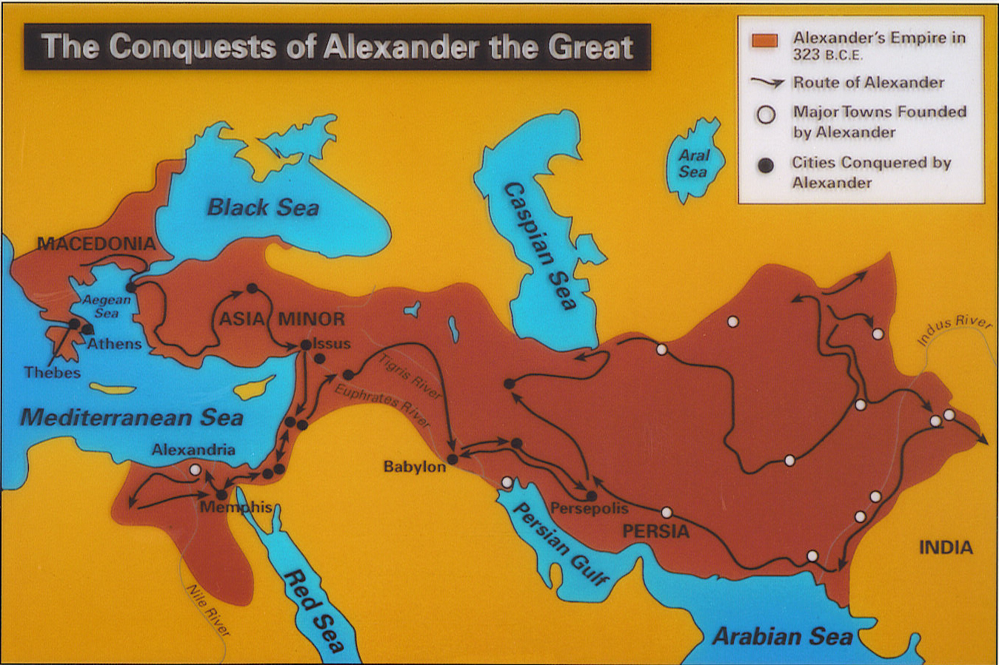

Slide 31
Chronology of the Times
BC 620 580 560 540 520 500 480 460 440 420 400 380
Babylon
Persia
World Empire
Nebuchad- nezzar
Cyrus
&
Darius
Darius Hystaspes
Artaxerxes Longimanus
Xerxes
1
2
3
4
70yrs Captivity
606-536 BC
70yrs Temple Destroyed
586-516 BC
Judah
Jeho-iakim
Zede-kiah
Joshua Zerubbabel
Ezra Nehemiah
Esther

Slide 32
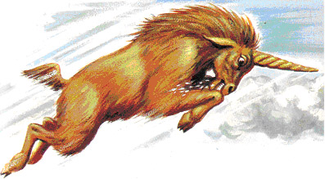
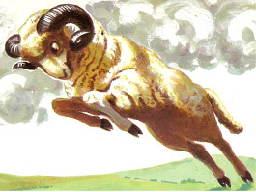
Granicus
Issus
Gaugamela

Slide 33
Alexandria
Alexandria
Alexandria
Alexandria
Alexandria
Alexandria
Alexandria
Alexandria
Alexandria
Alexandria
Alexandria
Alexandria
Alexandria

Slide 34
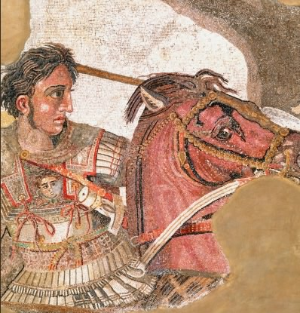
Issus
Hamath
HADRACH
Tyre
Damascus
Ekron
Alexandria
Ashkelon
Gaza
Jerusalem
Memphis
Siwa

Slide 35
The Conqueror of the World
Alexander the Great
Jesus the Christ
Divinely Appointed
Entitled “The Son of God”
Entitled “The King of Kings”
Dominion from Sea to Sea
Led by Example
Established a Following
Died at 32/33
Alexander & Christ

Slide 36
The Human and the Divine
Alexander
King of Greece
Violent, Unjust
Arrogant, Egotistic
Rode a War Horse
Declared war on the Nations
Enslaved the World
Died in Babylon
Unable to Save
Christ
King of Zion
Just
Lowly
Rode an Ass
Spake Peace to the Nations
Sent forth Prisoners
Died in Jerusalem
Saving Himself (mg)
Alexander & Christ

Slide 37
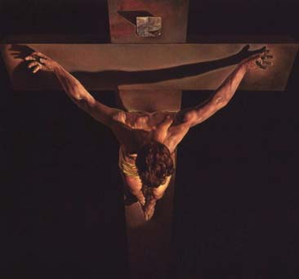
Although the Romans did not invent crucifixion they perfected it as a form of torture and capital punishment …
Crucifixion probably began among the Persians. Alexander the great introduced the practice to Egypt and Carthage, and the Romans appear to have learned it from the Carthaginians.
Journal of the American Medical
Association, v255, n11, p1458
Crucifixion

Slide 38
Thy King Cometh
Unto Thee
Then Jehu came forth to the servants of his lord: and one said unto him, Is all well? Wherefore came this mad fellow unto thee? And he said unto them, Ye know the man, and his communication.
And they said, it is false; tell us now. And he said, Thus and thus spake he to me, saying, Thus saith Yahweh, I have anointed thee King over Israel.
Then they hasted, and took every man his garment, and put it under him on the top of the stairs, and blew with trumpets, saying, Jehu is king.
2Kings 9:11-13
The
King

Slide 39
Thy King Cometh
Unto Thee
And when he had called the people unto him with his disciples also, he said unto them, Whosoever will come after me, let him deny himself, and take up his cross, and follow me.
For whosoever will save his life shall lose it,; but whosoever shall lose his life for my sake and the gospel’s, the same shall save it.
For what shall it profit a man, if he shall gain the whole world, and lose his own soul?
Mark 8:34-36
The
King

Slide 41
ZECHARIAH
Prophecies for the Last Days

Slide 42
Zechariah
The Seven Night Visions
1:1-6:8 Introduction and encouragement to those building the house of God
The Enacted Parables
6:9-15 The Coronation of the King Priest
Ch7 The Deputation from Bethel
Ch8 The Restoration of Jerusalem
The Shepherd King
Ch9 The Human Conqueror
Ch10 The Good Shepherd
Ch11 The Scattering of the Flock
The Day of Yahweh
Ch12 Israel to Seek the Good Shepherd
Ch13 Israel Cleansed and Restored
Ch14 The Day of Yahweh Cometh
Immediate Future
Near Future
Outline of the Book
Distant Future

Slide 43
Yahweh Hath Visited His Flock
The Appeal
10:1 Turn unto God
The Problem & the Solution
10:2-4 The Shepherds of the Flock
The Restoration of Israel
10:5-7 The Victory of the Flock
10:8-12 The Regathering of the Flock
Outline

Slide 44
The
Regathering
And I will set up a sign (Christ) among them (Judah), and I will send those that escape of them (the refined 1/3 of Judah Zech 13:8) unto the nations, to Tarshish, Pul and Lud …
And they shall bring all your brethren (scattered Jewry) for an offering unto Yahweh out of the nations.
Isa 66:19-20
The
Goodly Horse

Slide 45
The Conqueror
Alexander
Zechariah 9
A Mighty King
(Dan 11:3)
Rides a War Horse
(Bucephalus)
Leads an Army v8
Tyre Devoured v4
Ekron Ashamed v5
Cut off Pride of
Philistines v6
King shall Perish
from Gaza v5
Christ
Zechariah 10
Judah & Ephraim: Mighty men v5, 7
Judah: my Goodly
Horse in Battle v3
Leads an Army v5
Israel shall Devour
her Enemies (9:15)
Enemy Horsemen
Confounded (s/w) v5
Pride of Assyria
Brought Down v11
Sceptre of Egypt shall
Depart v11
Alexander & Christ

Slide 46
The Regathering
And it shall come to pass when all these things are come upon thee, the blessing and the curse and thou shalt call them to mind among all the nations, whither Yahweh thy God hath driven thee.
And shalt return to Yahweh thy God, and shalt obey His voice according to all that I command thee this day, thou and thy children with all thine heart, and with all thy soul;
That then Yahweh thy God will turn thy captivity, and have compassion upon thee, and will return and gather thee from all the nations, whither Yahweh thy God hath scattered thee.
Deut 30:1-3
The
Flock

Slide 47
The Regathering
Behold, I will send you Elijah the prophet before the coming of the great and dreadful day of the LORD: And he shall turn the heart of the fathers to the children, and the heart of the children to their fathers, lest I come and smite the earth with a curse.
Mal 4:5-6
Elijah the Tishbite was of the inhabitants of Gilead.
1Ki 17:1
The
Flock

Slide 48
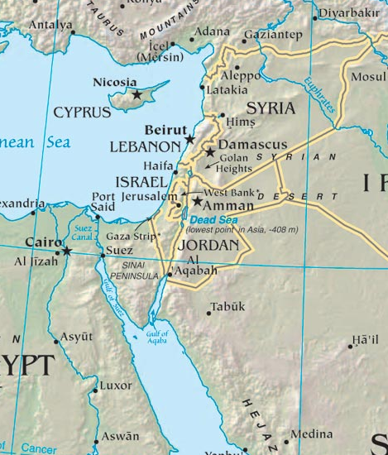
The North Country
Jer 3:18, 23:7-8, 31:8
ASSYRIA
Lebanon
Gilead
The Wilderness of the Peoples
Ezek 20:34-38
Rivers in the Desert Isa 43:18-21
Arabs Subdued Isa 21:13-17
A Highway Isa 19:23
Go Over Dryshod Isa 11:15, 27:12
As when they came out of the land of Egypt Isa 11:16, Hos 2:15, Mic 7:15
The
Second
Exodus
EGYPT

Slide 49
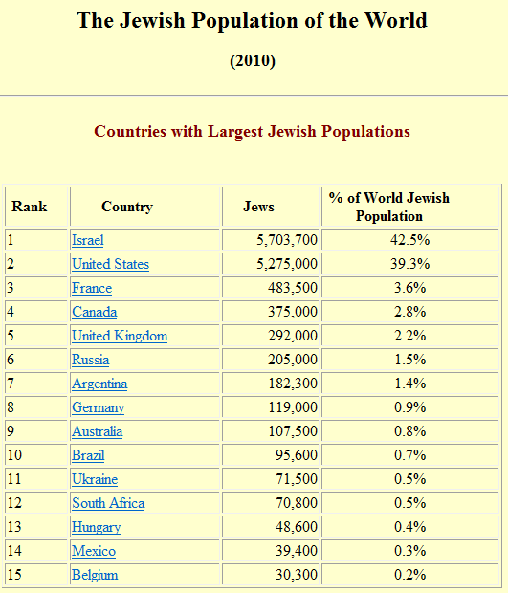
http://www.jewishvirtuallibrary.org/jsource/Judaism/jewpop.html
The
Flock

Slide 50
The
Regathering
Fear not: for I am with thee: I will bring thy seed from the east, and gather thee from the west.
I will say to the north, Give up; and to the south, Keep not back: bring my sons from far, and my daughters from the ends of the earth.
Isa 43:5-6
The
Flock

Slide 51
The
Regathering
And the remnant of Jacob shall be in the midst of many people as the dew from Yahweh, as the showers upon the grass, that tarrieth not for man, nor waiteth for the sons of men.
And the remnant of Jacob shall be among the gentiles in the midst of many people as a lion among the beasts of the forest, as a young lion among the flocks of sheep: who if he go through, both treadeth down and teareth in pieces, and none can deliver.
Mic 5:7-8
The
Flock

Slide 53
ZECHARIAH
Prophecies for the Last Days

Slide 54
Zechariah
The Seven Night Visions
1:1-6:8 Introduction and encouragement to those building the house of God
The Enacted Parables
6:9-15 The Coronation of the King Priest
Ch7 The Deputation from Bethel
Ch8 The Restoration of Jerusalem
The Shepherd King
Ch9 The Human Conqueror
Ch10 The Good Shepherd
Ch11 The Scattering of the Flock
The Day of Yahweh
Ch12 Israel to Seek the Good Shepherd
Ch13 Israel Cleansed and Restored
Ch14 The Day of Yahweh Cometh
Immediate Future
Near Future
Outline of the Book
Distant Future

Slide 55
Feed the Flock of Slaughter
The Judgement of AD70
11:1-6 The Invasion of AD70
The Cause of AD70
11:7-14 The Rejection of the Good Shepherd
The Result of AD70
11:15-17 The Rise of the Idol Shepherd
Outline

Slide 56
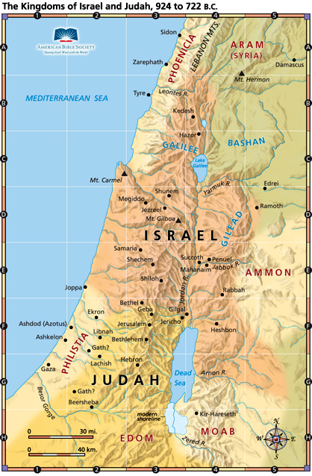
Lebanon Mts
Anti-Lebanon Mts
Bashan
The
Roman Invasion
Jordan
Jerusalem

Slide 57
Not Guilty!
Now when Titus came to this (upper) city, he admired some other places of strength in it, but particularly those strong towers which the tyrants, in their mad conduct, had relinquished; for when he saw their solid altitude, and the largeness of their several stones, and the exactness of their joints, as also how great was their breadth, and how extensive their length, he expressed himself after the following manner: “We have certainly had God for our assistant in this war, and it was no other than God that ejected the Jews out of these fortifications; for what could the hands of men, or any machines do towards overthrowing these towers.”
Josephus, Wars 6:9:1 (Whiston p587)
The
Roman Invasion

Slide 58
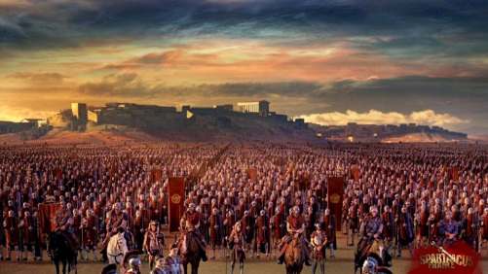
The Roman Invasion

Slide 59

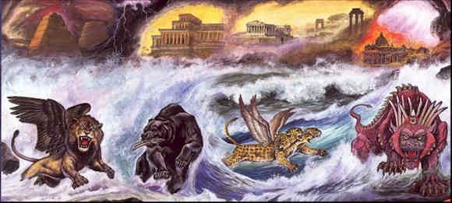
Daniel’s
4th
Beast

Slide 60
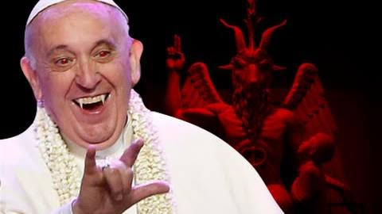
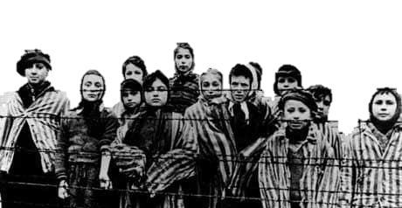
The
Idol Shepherd

Slide 62
ZECHARIAH
Prophecies for the Last Days

Slide 63
Zechariah
The Seven Night Visions
1:1-6:8 Introduction and encouragement to those building the house of God
The Enacted Parables
6:9-15 The Coronation of the King Priest
Ch7 The Deputation from Bethel
Ch8 The Restoration of Jerusalem
The Shepherd King
Ch9 The Human Conqueror
Ch10 The Good Shepherd
Ch11 The Scattering of the Flock
The Day of Yahweh
Ch12 Israel to Seek the Good Shepherd
Ch13 Israel Cleansed and Restored
Ch14 The Day of Yahweh Cometh
Immediate Future
Near Future
Outline of the Book
Distant Future

Slide 64
At the time of the end . . . The king of the north shall come against him like a whirlwind. Dan 11:40
Many countries shall be overthrown, but these shall escape (be delivered) out of his hand, even Edom and Moab. v41
He shall plant the tabernacles of his palace between the two seas in the glorious holy mountain; yet he shall come to his end and none shall help him. v45
He shall stretch forth his hand upon the countries: and the land of Egypt shall not escape.
And the Libyans and the Ethiopians shall be at his steps. v42-43
The Gogian Invasion
Dan 11

Slide 65
The Day of Yahweh
Zechariah 12 13 14
Invasion of the Land v1-3
Judah Refined v8-9
Jerusalem Taken v1-2
Natural Disasters v3-7
Topographical Changes v8,10
Plague & Civil War v4 v12-15
Judah Saved v7 v9
Jerusalem Saved v5-9 v14
The Deliverer Identified v6
Jewry Mourns v10-14
The Land Cleansed v1-5
The Nations Converted v16-19
Jerusalem Victorious v20-21
Yahweh is King v9,11
Outline

Slide 66
1004 BC David captures Jebus Judahite
925 BC Pharaoh Shishak Egyptian
597 BC Nebuchadnezzar Babylonian
586 BC Nebuchadnezzar Babylonian
301 BC Ptolemy I Grecian
198 BC Antiochus III Grecian
141 BC Simon Maccabee Judahite
63 BC Pompey Roman
37 BC Herod the Great (Roman)
70 AD Titus Roman
132 AD Simon Bar Kochba Judahite
135 AD Hadrian Roman
614 AD Persians conquer Byzantines
629 AD Heraclius Byzantine
638 AD Caliph Omar Arabic
878 AD Egypt conquers Abbassids
905 AD Abbassids Arabic
941 AD Egypt conquers Abbassids
1071 AD Seljuk Turks Turkish
1099 AD Crusaders Holy Roman
1187 AD Saladin (Kurd) Arabic
1229 AD Crusaders Holy Roman
1244 AD Mamluks Turkish
1260 AD Mongols. Mamluks immediately regain
1516 AD Sultan Selim I Ottoman
1917 AD Allenby British
1948 AD Jordanian Army Arabic
1967 AD Israeli army captures Jerusalem Israeli
A Cup of Trembling
Recorded Captures of Jerusalem

Slide 67
Jews in the Land
Outside Jerusalem
Jerusalem
Governors of Judah
House of David
Tents of Judah
Inhabitants of Jerusalem
The Jews

Slide 68
Zechariah 13:9
And he shall bring the third part
Through the fire (Divine Intervention)
Servants speak Hebrew, know God Gen 43:23
Sons dine eldest to youngest Gen 43:33
Bags searched eldest to youngest Gen 44:12
And I will try them as gold is tried
“Ye are spies” Gen 42:14
Money in the sacks Gen 42:27
The silver cup Gen 44:12
They shall call on my name
Is your father yet alive? Gen 42:14
Is your father well? Gen 42:27
Go in peace to your father Gen 44:17
Lest I see evil come on my father Gen 44:34
I will say, It is my people
I am Joseph your brother Gen 45:4
The
Repentance of Judah

Slide 70
ZECHARIAH
Prophecies for the Last Days

Slide 71
Zechariah
The Seven Night Visions
1:1-6:8 Introduction and encouragement to those building the house of God
The Enacted Parables
6:9-15 The Coronation of the King Priest
Ch7 The Deputation from Bethel
Ch8 The Restoration of Jerusalem
The Shepherd King
Ch9 The Human Conqueror
Ch10 The Good Shepherd
Ch11 The Scattering of the Flock
The Day of Yahweh
Ch12 Israel to Seek the Good Shepherd
Ch13 Israel Cleansed and Restored
Ch14 The Day of Yahweh Cometh
Immediate Future
Near Future
Outline of the Book
Distant Future

Slide 72
The Day of Yahweh
Zechariah 12 13 14
Invasion of the Land v1-3
Judah Refined v8-9
Jerusalem Taken v1-2
Natural Disasters v3-7
Topographical Changes v8,10
Plague & Civil War v4 v12-15
Judah Saved v7 v9
Jerusalem Saved v5-9 v14
The Deliverer Identified v6
Jewry Mourns v10-14
The Land Cleansed v1-5
The Nations Converted v16-19
Jerusalem Victorious v20-21
Yahweh is King v9,11
Outline

Slide 73
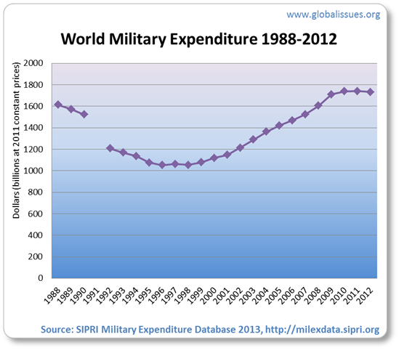
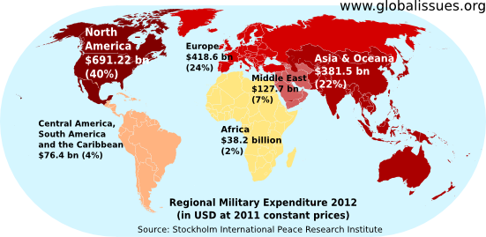
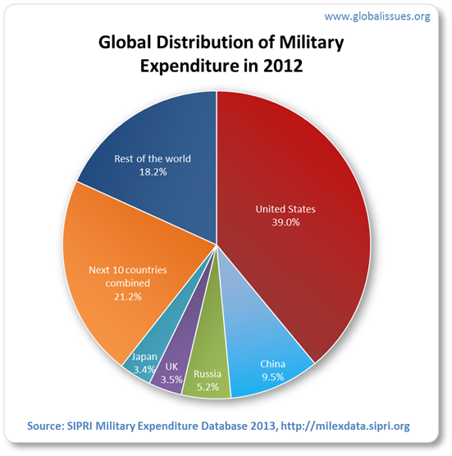
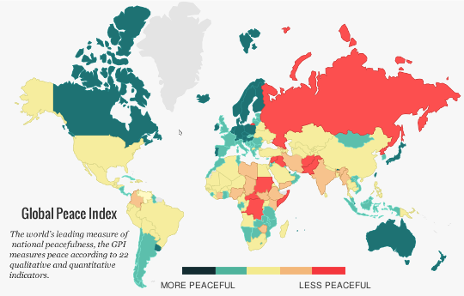
Military Spending
Global Peace Index

Slide 74
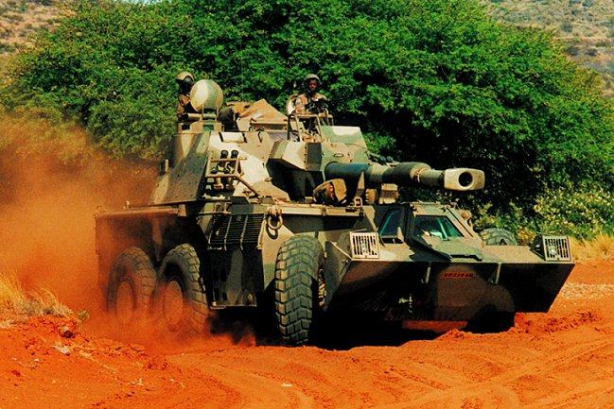
Denel G6

Slide 75
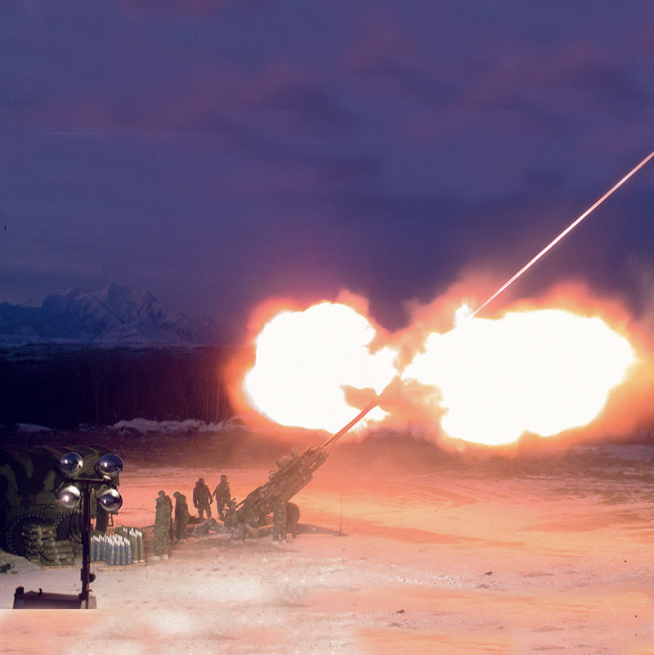
British Aerospace M777

Slide 76
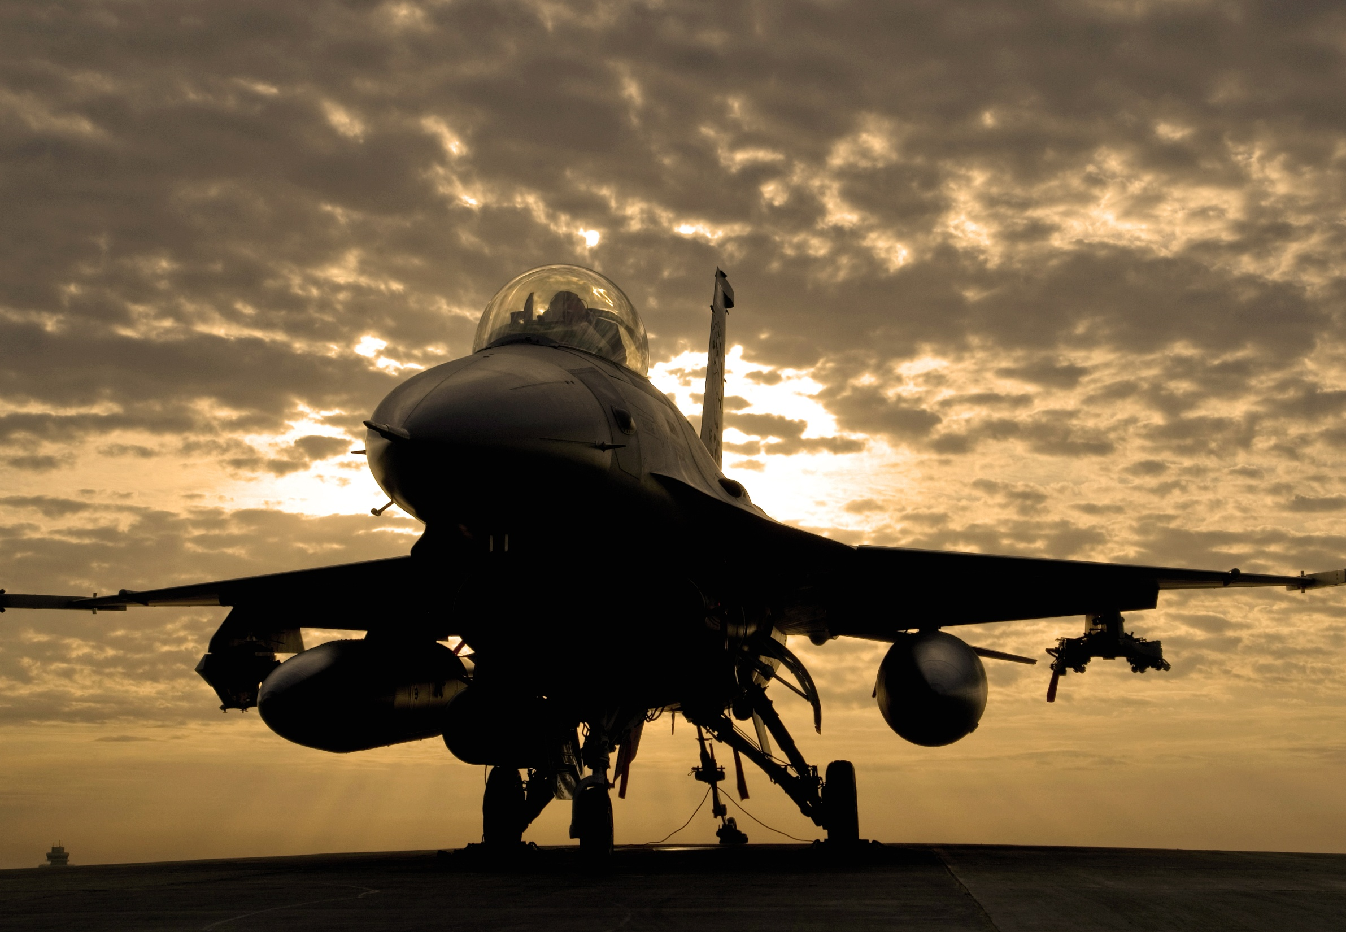
Lockheed Martin F15E

Slide 77
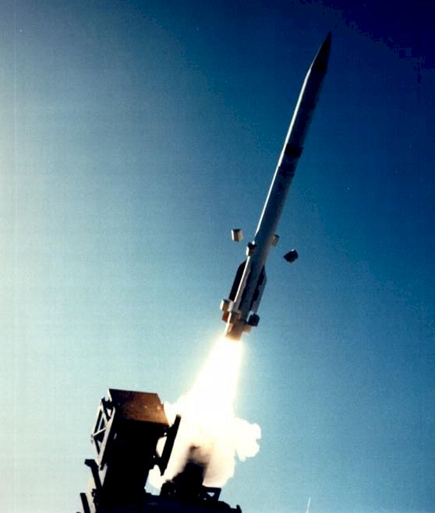

Slide 78
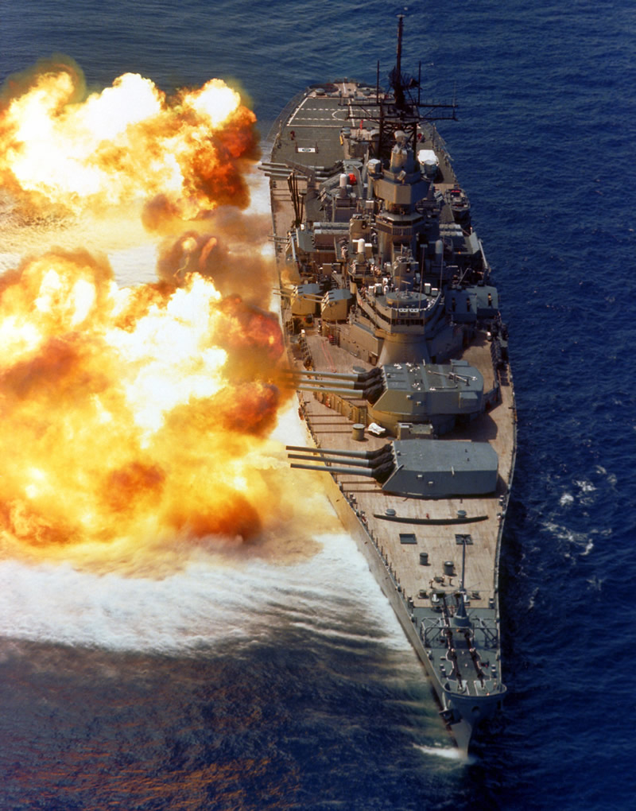

Slide 79


Slide 80
Hinder
Sea
Geba
The Longest Day
Jerusalem
Former
Sea
Yahweh Shammar
Rimmon

Slide 81
The Day of
Yahweh
And it shall come to pass in that day,
That there shall be no light,
The bright stars shall be withdrawn;
And it shall be a day by itself.
The same shall be known unto Yahweh
Not day, Nor night,
But it shall come to pass that at evening
Time there shall be light.
Zech 14:6-7 (Roth)
Battle

Slide 82
The Longest Day
Beth-Horon
Gilgal
Aijalon
Gibeon
Joshua 10

Slide 83
The Day of
Battle
Then Yahweh answered Job out of the whirlwind, and said …
Hast thou entered into the treasures of the snow? Or hast thou seen the treasures of the hail?
Which I have reserved against the time of trouble, against the day of battle and war?
Job 38:22-23
Snow & Hail

Slide 84
The Battle of
Beth-Horon
Joshua 10 Zech 14
v14 Yahweh will Fight v3
v1 Against (king of) Jerusalem v14
v7 Judah fights at Jerusalem v14
v13 Evening is Light v6-7
v11 Hailstones Ezek 38:22
v40 No more Canaanites v21
9:27 Everyone left will Worship v16
Battle

Slide 85
The Longest Day
Geba
Joshua 10
Rimmon

Slide 86
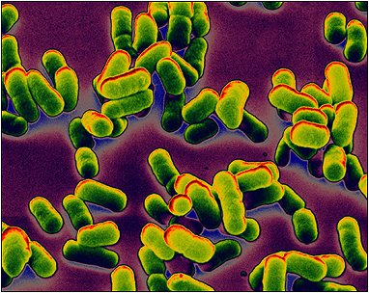
The Plague
Now also many nations are gathered against thee, that say, let her be defiled, and let our eye look upon Zion.
But they know not the thoughts of Yahweh, neither understand they His counsel: for He shall gather them as sheaves unto the floor.
Mic 4:11-12
Battle

