Slide 1
Integrating Courses into the Ecclesia
Prepared by Bro. Ted Hodge Jr
Shippensburg Evening Program

Slide 2
Why ecclesial courses?
Marriage and parenting knowledge and skills are important building blocks for healthy ecclesias
Practical matters related to these areas are not typically covered in sufficient depth in other ecclesial formats
A strategy to be proactive; deal with fewer or smaller issues by enriching before sometimes more serious problems arise

Slide 3
What they are not for?
To collect people together who have current serious marriage struggles or issues
To share marriage issues with anyone other than your partner

Slide 4
The Plan
Lots of planning and ecclesial support required
Special Friday night refreshments
Saturday refreshments
Saturday lunch
Babysitters – lots of them!
Sunday lunch with ecclesia
Facility organizer
Chairman
Facilitator
Support couple
Accommodations (for those not local)

Slide 5
The Concept
15 - 25 minute sessions with facilitator
10 -15 minute exercises/workshops private to couple only
Typically limited to 15 couples – we took 20 couples
Used trailers and even a car in addition to private hall locations for workshops

Slide 6
The Facilitator
Need a spiritual facilitator of some experience and ability
We decided that it would be best to have someone not local
Bro. John Evans from Adelaide, Australia for the Marriage Course
Regularly doing these courses along with many other marriage types of services

Slide 7
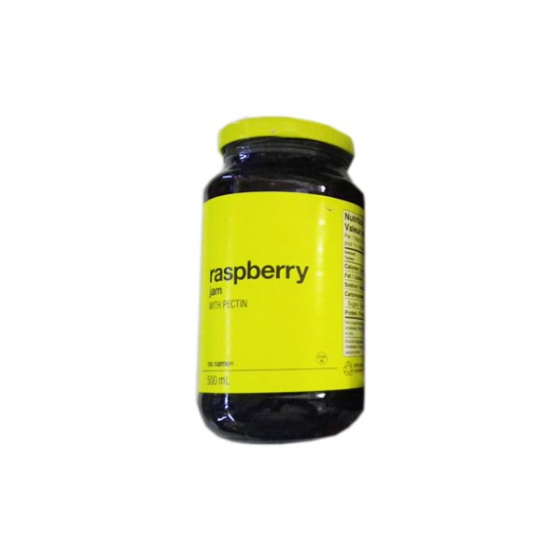
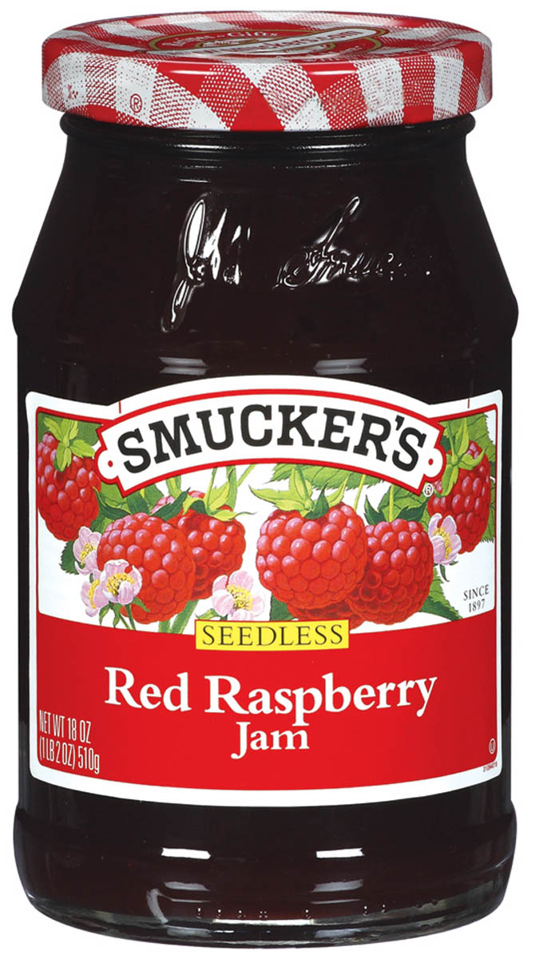

Slide 8
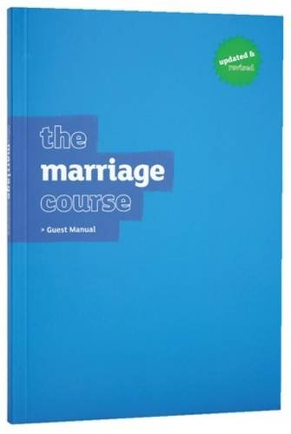
The Workbook
Using the Marriage Course by Nicky and Sila Lee used many times in Australia – best available
When using non-Christadelphian materials – warning/edits as necessary

Slide 9
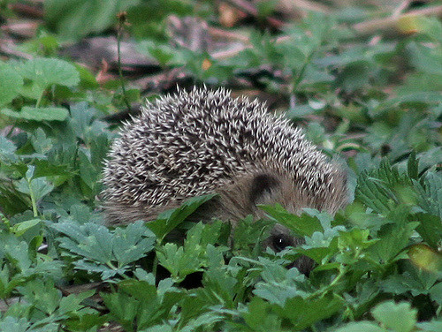
Sample Exercise
Useful for all – no need to be married
You will know once you are done if you are a Hedgehog or Rhino!

Slide 10
The Schedule – Friday night
7:00pm Special Friday night refreshments first – coffee machines and pumpkin and chocolate whoopie pies!
Couples without children – what a strange sight
Relax – interact in a very positive environment
7:30pm – 9:00pm sessions and couples private exercises/workshops

Slide 11
The Schedule – Saturday
9:30am – 4:30pm pattern repeats through day – lunch and two breaks
4:30pm – parents go out on dinner date
4:30pm kids come to hall for dinner until 8:00pm with supervised activity

Slide 12
The Schedule – Sunday
Exhort to ecclesia on theme
1:30pm – 4:30pm complete the course

Slide 13
Our Experience
Really good feedback – very much appreciated by the couples
Everyone attended, even some older couples – great support – helped everyone including some struggling marriages
Follow-up a year later – dinner for two’s at the hall – restaurant style and skyped in Bro. John for a session and had Bro. Ian Macfarlane do a second session – provided a useful reminder

Slide 14
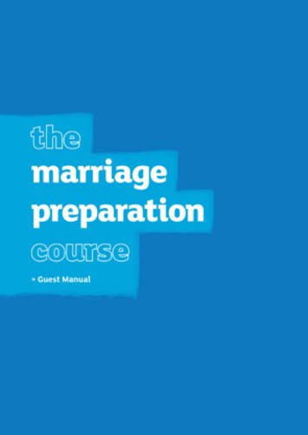
Other Follow-up in Ecclesia
Marriage classes with a couple once engaged
Marriage/Courtship classes with couples before engagement (using “the marriage preparation course”)
Marriage classes with some struggling couples

Slide 15
Parenting
Same pattern excluding Sunday afternoon sessions
Bro. Paul Styles did the sessions/ Bro. Ted the workshops using a parallel workbook on Parenting for children ages 0 -10
Plan to do Parenting for Teenagers in the future
Bro. Paul’s material is very good and linked to scripture
People appreciate the time in the workshops with the other couples on this subject
Added a discipline segment as this was weak, the workbook had a few more deficiencies

Slide 16
The Workbook
Used this one 2017
Plan for using in future

Slide 17
Sample Exercise
Useful for all – no children required
Parenting Styles

Slide 18
Parenting Styles
Authoritative: Deemed as most effective, high expectations, understanding, supportive. Provides a environment that allows a child to thrive.
Authoritarian: Defined as strict parents, most demanding, don't respond to their children's request for an open dialogue. They set rules and punish their children in an effort to obtain obedience.

Slide 19
Parenting Styles
Indulgent: Permissive, extremely lenient, avoid confrontation, very nurturing, don't like to set boundaries, let the child make the decision - usually parents who were raised in a authoritarian environment.
Neglectful: Neglect their children's basic needs, not there for their children emotionally or physically.

Slide 20
Parenting Styles
WARM
Authoritative
Indulgent
FIRM
NOT FIRM
Authoritarian
Neglectful
NOT WARM

Slide 21
PPP

Slide 22
Plan Prioritize Protect

Slide 23
Daily Weekly Monthly Yearly

Slide 24
Challenges
Need enough couples to do it – invitations can go to surrounding ecclesias
A lot of work – a once a year or less activity – cooperative effort
If an overseas person is used – expensive - distant geographical areas could work together to cover costs

Slide 25
Why do COURSES in your ecclesia?
Some people do not have good role models from their childhood in terms of marriage or parenting
Without this in many cases we are relying on information from the world
We need leadership and vision on these matters
Impact our young couples and the future ecclesia
A strategy to be proactive; deal with fewer or smaller issues by focusing on preparation and enrichment activity

